Slide 1
E-commerce Sales Analysis & Business Insights
Data Analytics Intern
Name: Yarrinti ReddyRani
Tools Used: Power BI, excel

Slide 2
Project Objective
To analyze sales performance using data analytics techniques
To identify top performing products and categories
To understand regional sales trends
To generate business insights using an interactive Power BI dashboard

Slide 3
Dataset Overview
Dataset Name: E-commerce Sales Dataset
The dataset consists of 3,500 sales records
It includes 7 columns such as product, region, sales and profit, etc.
Each row represents a single sales transaction.
The dataset enables analysis of sales performance across different regions and categories.
The dataset is structured and suitable for data analysis and business insights generation.

Slide 4
Data Cleaning & Preparation
Checked for missing values
Removed duplicate records
Standardized date formats
Verified column data types
Prepared dataset for further analysis

Slide 5
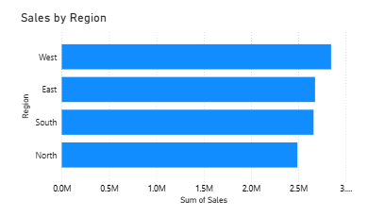
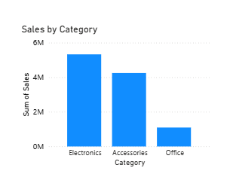
Sales Performance Overview
West region generated the highest sales
Technology category shows strong performance

Slide 6
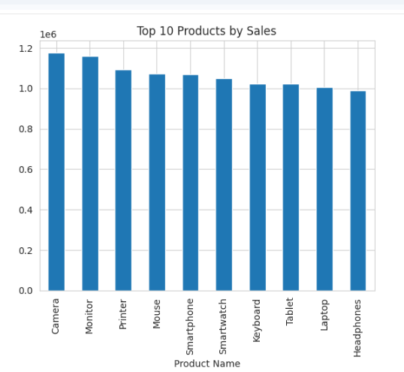
Product & Category Analysis
Technology category contributed the highest revenue
Some products generated high sales but low profit

Slide 7
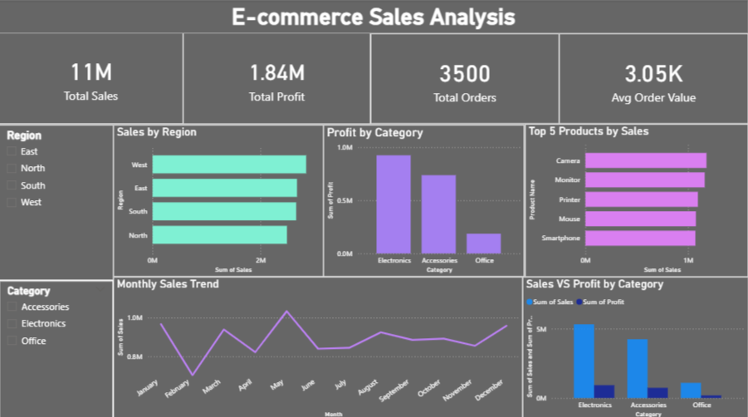
Interactive Dashboard
Dashboard allows users to analyze sales by region, category and product using interactive filters.

Slide 8
Hypothesis Test
Test Used: One-Way ANOVA
Compared sales across four regions (East, West, North, South)
P-value > 0.05
Failed to reject the null hypothesis
Conclusion:
There is no statistically significant difference in sales between regions.

Slide 9
Key Insights
Electronic category drives most revenue
West region has strong sales performance
Profit margins vary across categories

Slide 10
Business Recommendations
• Focus marketing in high-performing regions
• Improve pricing for low-profit products
• Increase promotion for top products

Slide 11
Conclusion
Data analysis helps businesses understand sales patterns and make informed decisions using Power BI dashboards.

